Slide 1
SIT113 Cloud Computing and Virtualisation
Week 1, Class 1
Unit Introduction

Slide 2
Outline
Unit Introduction
Welcome
Unit Staff
Textbooks
Topics
Unit Site
NetLab+ VE
GLOs
ULOs
Assessment
eValuate

Slide 3
Unit Staff
Dr Majeed Alajeely
Roles: Unit Coordinator and Lecturer
Email: majeed.alajeely@deakin.edu.au

Slide 4
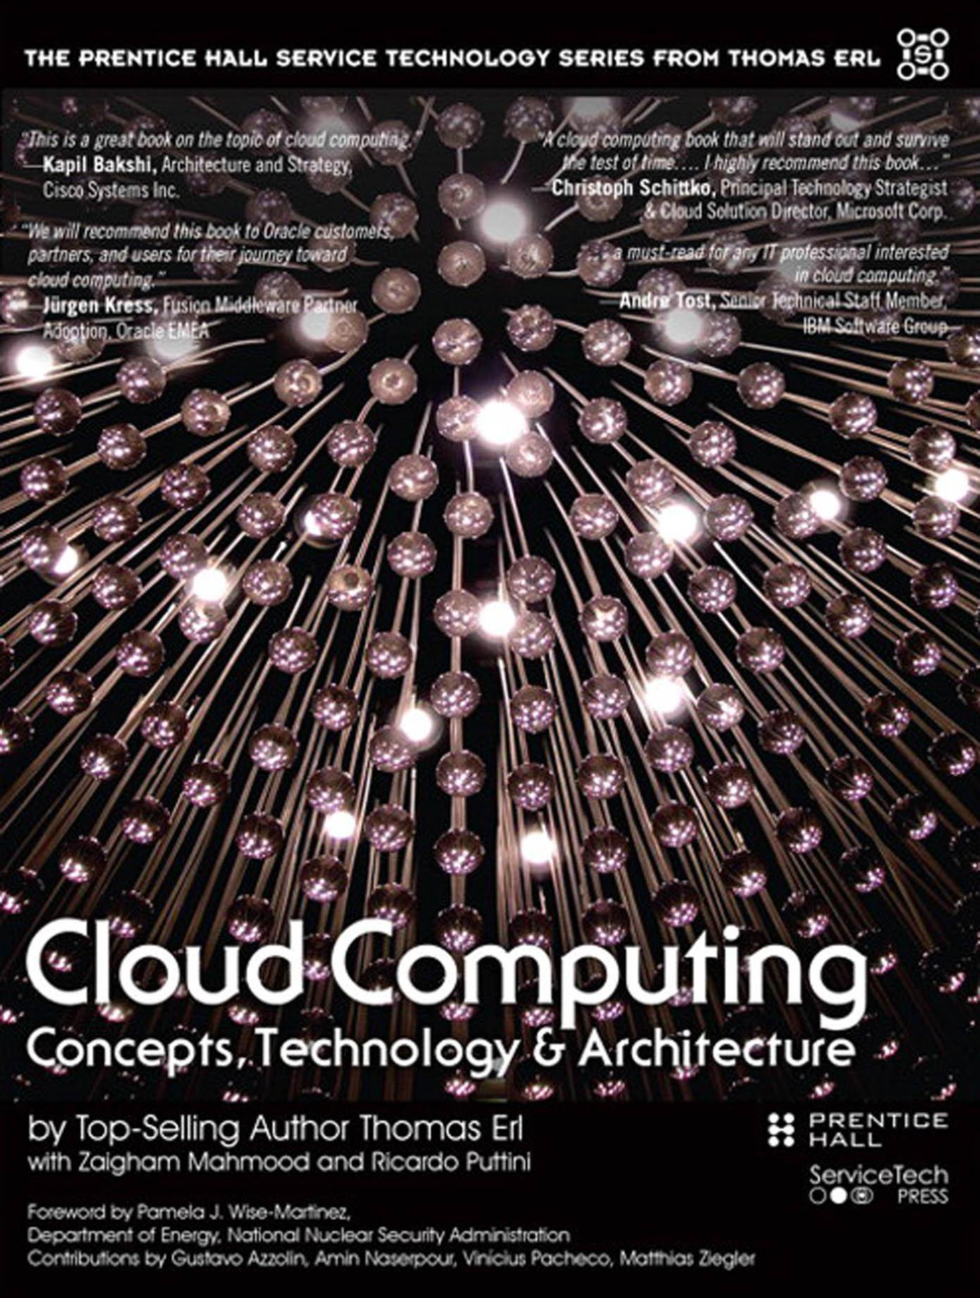
Prescribed Textbook
Thomas Erl, Cloud Computing: Concepts, Technology & Architecture, Prentice Hall, 2013.

Slide 5
Topics
Week 1. Introduction
Week 2. Clouds Basics and Linux
Week 3. Networking
Week 4. Storage
Week 5. Virtualization
Week 6. Cloud Technologies and Mechanisms
Week 7. Cloud Architectures
Week 8. Working with Clouds
Week 9. Azure
Week 10. AWS
Week 11. Review

Slide 6
SIT113 Unit Site in Moodle
https://moodle.deakincollege.edu.au
Take the time to get familiar with the resources available in the unit site.
Make sure you check back regularly!

Slide 7
SIT113 Unit Site in Moodle
The unit site contains:
News / Announcements
Discussion Forum
Class Slides and Recordings
Weekly Practical Tasks
Assessment Tasks and Submission
And other useful resources!

Slide 8
NetLab+ VE
https://vmlab.it.deakin.edu.au/
Access to the “NetLab+ VE” virtualization system
Access to the “VMware vSphere Install, Configure, and Manage” certification curriculum
Used during practical classes

Slide 9
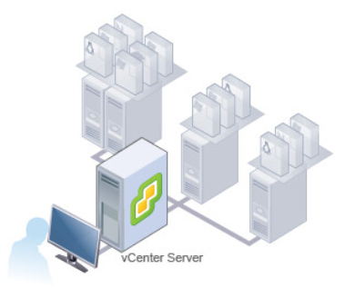
NetLab+ VE

Slide 10
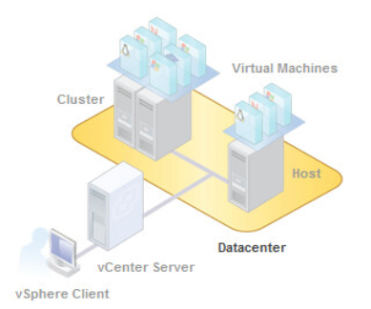
NetLab+ VE

Slide 11
Deakin College Graduate Learning Outcomes
Discipline-specific knowledge and capabilities: appropriate to the level of study related
Communication: using oral, written and interpersonal communication to inform, motivate and effect change
Digital literacy: using technologies to find, use and disseminate information
Critical thinking: evaluating information using critical and analytical thinking and judgment

Slide 12
Deakin College Graduate Learning Outcomes
Problem solving: creating solutions to authentic (real world and ill-defined) problems
Self-management: working and learning independently, and taking responsibility for personal actions
Teamwork: working and learning with others from different disciplines and backgrounds
Global citizenship: engaging ethically and productively in professional contexts, with diverse communities and cultures in a global context

Slide 13
Unit Learning Outcomes
At the end of this unit, students will be able to:
utilise a range of cloud computing tools and technologies to design and analyse cloud computing systems
evaluate the characteristics and applications of cloud-based and non-cloud solutions to discuss potential benefits, risks and peculiarities from a technical and non-technical perspective
evaluate given requirements and select the most appropriate cloud technology to solve given computing problems

Slide 14
Assessment
Assessment Task 1
20%: Ten online quizzes (2% each)
Assessment Task 2 and 3
20%: Two assignments (10% each)
Assessment Task 4
60%: Final examination

Slide 15
Assessment
Learning Outcomes are Assessed:
ULO Pass Marks
 | Task 1 | Task 2 | Task 3 | Task 4 | Overall Weighting
ULO1 | 20% |  |  | 10% | 30%
ULO2 |  | 10% |  | 25% | 35%
ULO3 |  |  | 10% | 25% | 35%
 | Pass Mark
ULO1 | 12 / 30
ULO2 | 14 / 35
ULO3 | 14 / 35

Slide 16
Assessment
Grade | Requirements to achieve Grade
High Distinction (HD) | A student must achieve all ULOs and obtain an overall mark of at least 80 to receive a high distinction grade (HD).
Distinction (D) | A student must achieve all ULOs and obtain an overall mark of at least 70 to receive a distinction grade (D).
Credit (C) | A student must achieve all ULOs and obtain an overall mark of at least 60 to receive a credit grade (C).
Pass (P) | A student must achieve all ULOs and obtain an overall mark of at least 50 to receive a pass grade (P).
Fail (N) | A student that does not achieve all ULOs or does not obtain an overall mark of at least 50 will receive a fail grade (N). If a student does not achieve all ULOs but achieves a mark of 50 or more, their final result will be 44 N.

Slide 17
Student Evaluation of Teaching and Unit Surveys
Towards the end of the teaching period you may be emailed a link to the unit evaluation survey.
I encourage you to participate, as constructive feedback from students will assist us to make improvements to this unit where necessary.

Slide 18
Student Evaluation of Teaching and Unit Surveys
In previous versions of this unit, students have told us that these aspects of the Unit have helped them to achieve the learning outcomes:
multiple attempts at online quizzes
VMware labs to understand concepts
access to VMware labs during practicals and outside of practicals
practicals were well made, informative, enjoyable, and helped with the lecture content
classes support assessment tasks

Slide 19
Student Evaluation of Teaching and Unit Surveys
They also made suggestions for improvement, and so this is what we have done:
reduced the amount of information presented during classes
rearranged class and practical materials so that practicals are better supported by lectures
updated class materials to better support practicals
included new topics on Azure and AWS

Slide 20
Summary
Administrative Information
Welcome
Unit Staff
Textbooks
Topics
Unit Site
NetLab+ VE
GLOs
ULOs
Assessment
eValuate

Slide 21
Questions

